Slide 1
BCI433 - IBM i Business Computing
Week 1: Introduction to IBM i &
Writing CLLE Programs

Slide 2
Agenda
Welcome – Course introduction
Intro to IBM i
What is IBM i?
Basic operations in ACS
Definitions
Write CLLE Programs
Lab 1
QuickCheck (Questions)

Slide 3
Lesson Objectives
The objectives of the lecture and lab 1:
To familiarize you with basic IBM i (OS) operations in 5250 Emulator, i.e. green/white screen environment.
Explain the definitions: library lists, system values, and more
Introduction to tradition IBM i development environment, and write/run your first CL program(s)
Introduction to printing
Install ACS and RDi on your PC

Slide 4
Welcome
Welcome to BCI433
Course introduction
On Blackboard
Course outline
Course website
IBM i 7.4 Documentations

Slide 5
IBM i – A Midrange System
IBM’s product offerings/lines
System z
Mainframes!
System i / IBM i on Power System
i means integration
IBM’s midrange server line designed to grow with a business
System p
(formerly RS/6000) AIX and Linux on Power System
IBM’s RISC/UNIX-based server and workstation line designed to accommodate small to medium size businesses
System x
PCs!!

Slide 6
Power Systems
In April 2008, IBM officially merged System i and System p under the same name – Power Systems with identical hardware and a choice of operating systems.
Being as System i, Power Systems run IBM i.
Being as System p, Power Systems run AIX or Linux.
BCI433 covers mainly the System i part of IBM Power Systems, so we mix the usage of IBM i and Power Systems.

Slide 7
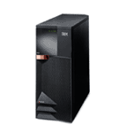
IBM i
Developed by IBM to support medium to large scales business
i means iNTEGRATION!
A server designed for the on-demand challenges of Web and e-business, as well as core On-line Transaction Processing (OLTP) workloads, with support for multiple operating and application environments.

Slide 8
The History of IBM i
System 3
1969 - 1985
System 32
1975 - 1984
System 34
1977 - 1985
System 36
System 38
1980 - 1994
1983 - 1994
(OS/400 on) AS/400
1988 – present
(i5/OS on) iSeries
2000 - present
(IBM i on) System i
2006 - 2007
IBM i on Power Systems
2008 - present

Slide 9
A Naming Nightmare
The operating systems for IBM’s midrange server line:
IBM i – runs on Power Systems or System i.
i5/OS (OS/400 V5R3)– runs on iServers (i5, i Series).
OS/400 – runs on AS/400.
CPF – runs on System 38.
……
IBM i, i5/OS and OS/400 are basically the same.

Slide 10
IBM i – A Business System
Used by Banks, Retailers, …, e.g.
McDonald's Canada
Canadian Tire (head office and one in every store)
Kraft Foods
Loblaws
Holt Renfrew
Coca Cola
more…

Slide 11
IBM i – A Database System
Database is built in...not added on
All data accessed through integrated data base
DB2 UDB for IBM i does not have a data base package
IBM i is a data base machine
IBM i was designed with a relational database

Slide 12
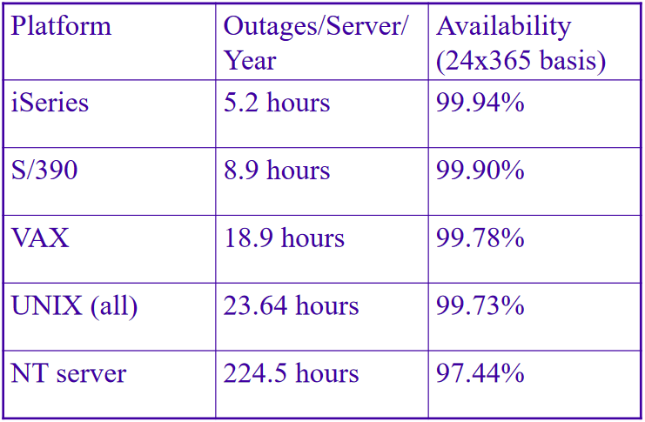
RELIABLE – Why we need IBM i
“Platform Availability: Can You Spare a Minute” Gartner Group study

Slide 13
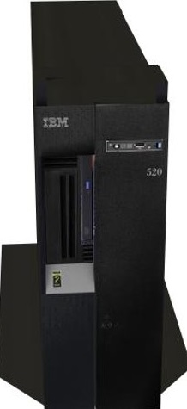
Power System in Seneca
Server name: ZEUS
Installed: in January, 2009.
Model: IBM Power 520 Express
URL: zeus.senecac.on.ca
PowerVM Partitioning IBM AIX, IBM i, and Linux on a Single POWER6 System

Slide 14
Connectivity Tools
Access Client Solutions (ACS)
5250 Emulator, Navigator for i
Production Environment
Rational Developer for i (RDi)
The Eclipse-based Rational IDE
MochaSoft
5250 Emulator
Websphere Devbelopment Studio Client (WDSC) (large install)

Slide 15
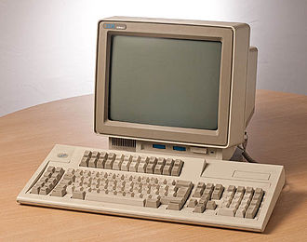
Let’s sign on!
Using IBM i ACS (5250 Emulator, Green/White Screen)
Find the Handouts file ACS_Setup-2197.pdf, then follow the instruction to install ACS.
Your IBM i (Zeus) server userid/password can be found in the Grade Center on Blackboard
IBM 3486 Terminal with 5250 functionality, From Wikipedia

Slide 16
Simple CL Commands
Sign off: SIGNOFF
Run a menu "main": GO MAIN
Send message "HELLO" to yourself, e.g. DS433A35:
SNDMSG MSG(HELLO) TOUSR(DS433A35)
Display message: DSPMSG
Run program STRJOB: CALL StrJob
Run program STRJOB which is in library QGPL:
Call QGPL/STRJOB

Slide 17
Commonly Used Function Keys
Function Key | Function
F1 | Help
F3 | Exit
F4 | Prompt
F5 | Refresh Screen
F9 | Retrieve Previous Command
F12 | Cancel
F23 (Shift+F11) | More options
F24 (Shift+F12) | More function keys

Slide 18
Definitions

Slide 19
Objects
Everything on the IBM i that has a name and takes up space in storage and is not temporary – object
On IBM i, everything is an object
on Unix, everything is a file
On IBM i, objects have types.
The object type determines what programs are allowed to act upon that object
The object types used in Lab 1:
*USRPRF, *LIB, *CMD, *MSGQ, *OUTQ, *FILE and *PGM

Slide 20
Libraries
Library: an object whose purpose is to ‘store’ and index other objects.
i.e. objects are ‘stored’ in libraries.
like a directory in Unix/Windows
Object Type is *LIB
QSYS is the only library that can contain other libraries
Allowing access to an object additionally requires allowing access to the library that contains the object

Slide 21
About Your Student Library
Your 'student library' is the library which has the same name as your Userid or profile.
===> WRKOBJ DW433C45
What Objects Do You Have (in your course library)?
An Output Queue which has the same name as your userid.
All objects which you create will be stored in your current library which is your student library by default.

Slide 22
Library List
Used when an object is referred to without including the library name where it is stored
Library List consists of:
System portion of library list, which is QSYSLIBL and usually is a list of IBM libraries with IBM objects
Current library, which is your student library
User Portion of library list, which is QUSRLIBL and usually contains libraries with commonly shared user objects
A system administrator decides what libraries are included
Library Lists are built when you sign on and are deleted when you signoff

Slide 23
System Values
Variables maintained by the operating system to set up IBM i.
Examples:
QSYSLIBL – System libraries for library list
QUSRLIBL – User libraries form library list
The command to display a system value:
DSPSYSVAL QSYSLIBL

Slide 24
User Profiles
Each Userid has a User Profile which describes the user and user's authorities
User Profile Contains information such as
Current Library,
default output queue and message queue
password,
class of user,
…

Slide 25
Work With Active Jobs
A 'job' is any and every piece of work on the IBM i.
Jobs run in subsystems rather than directly in IBM i
Two types:
interactive jobs – start when a user signs on
batch jobs – background, e.g. compile a program
Command WRKACTJOB shows you:
all the jobs that are currently running in IBM i
jobs' status.
the option to end jobs

Slide 26
Output Queues & Spooled files
A queue is a line-up! A place (object) where things wait.
Examples of IBM i queues:
job queues: where batch jobs wait
message queues: where messages wait
output queues: where spooled files wait to print
Object type?
Spooled files: Formatted output (in output queue) ready for printing

Slide 27
Source Physical Files
Source physical file – object that stores program source code
Object type: *FILE
A source file may have many members.
Each member of a source physical file is a separate program (code).
When a member, e.g. a CLLE code, is successfully compiled a new program object (*PGM) is placed in a library (usually your current library)

Slide 28
PDM
Program Development Manager (used in green/ white screen)
The tool that gives easy access to a programmer’s stuff (libraries, files, and members)
WRKLIBPDM *LIBL
WRKOBJPDM DW433C45
WRKMBRPDM QCLLESRC
"WRK", i.e. work with
What is the Unix/Linux command or English word that is equivalent to "WRK" in IBM i?

Slide 29
Creating CL Program
About CL
What does CL stand for?
CL program type: CLLE
CL Code is between : PGM and ENDPGM
To list all members in source physical file QCLLESRC:
WRKMBRPDM QCLLESRC
To work with compiled CL program - *PGM object:
WRKOBJPDM DW433C45
To see your compiler listing
WRKSPLF, or
Use Printer Output from ACS – in pdf

Slide 30
LPEX / SEU Editor Commands
Command (on line #) | Operation
I | Insert a line
D | Delete a line
C | Copy a line
M | Move a line
A | Paste After
B | Paste Before
CC, CC | Copy multiple lines
DD, DD | Delete multiple lines
MM, MM | Move multiple lines

Slide 31
Lab 1 demo

Slide 32
Homework
Review lecture notes.
Setup ACS on your PC
Complete Lab 1
Install RDi 9.6 (for Lab 2 in next week)

Slide 33
The End

